Slide 1
Transmission Control Protocol (TCP)
Copyright © The McGraw-Hill Companies, Inc. Permission required for reproduction or display.

Slide 2
15-1 TCP SERVICES
TCP lies between the application layer and the network layer, and serves as the intermediary between the application programs and the network operations.

Slide 3
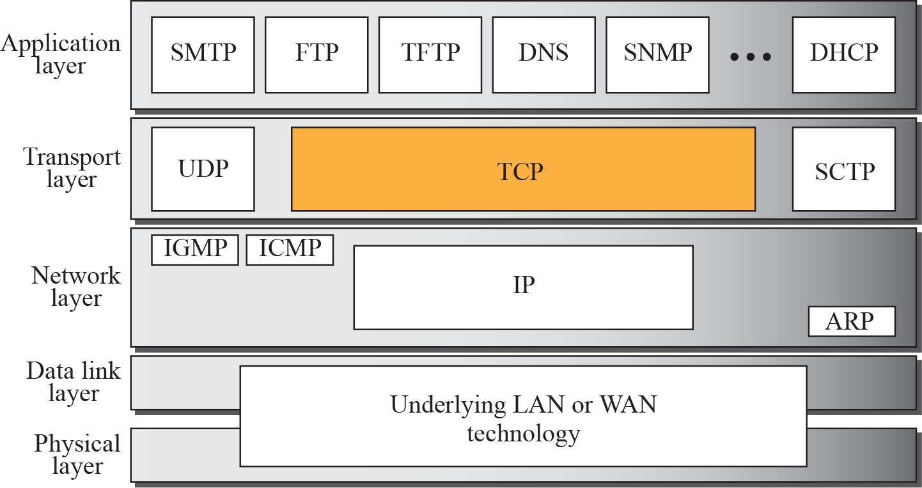
Figure 15.1 TCP/IP protocol suite

Slide 4
Process-to-Process Communication
Stream Delivery Service
Full-Duplex Communication
Multiplexing and Demultiplexing
Connection-Oriented Service
Reliable Service

Slide 5
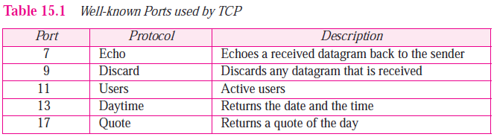
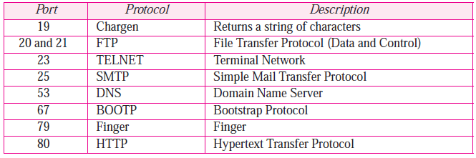
Process-to-Process Communication
TCP provides process-to-process communication using port numbers.
Some well-known port numbers used by TCP.

Slide 6
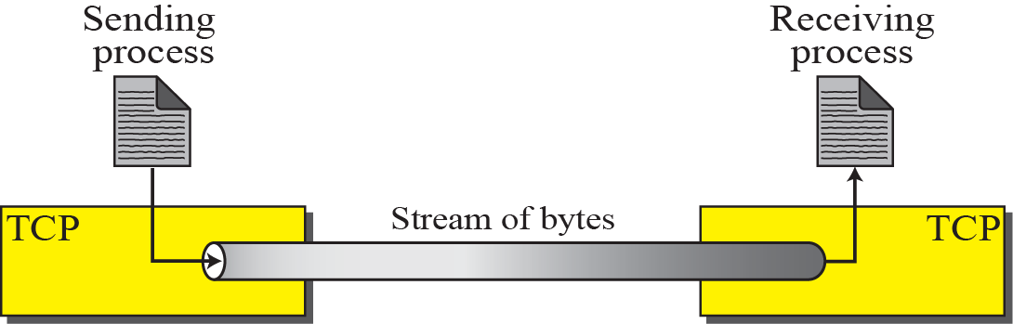
Figure 15.2 Stream delivery
Stream Delivery Service
TCP is a stream-oriented protocol.
Allows the sending process to deliver data as a stream of bytes and allows the receiving process to obtain data as a stream of bytes.
TCP creates an environment in which the two processes seem to be connected by an imaginary “tube”.
Sending process produces (writes to) the stream of bytes and the receiving process consumes (reads from) them.

Slide 7
Figure 15.3 Sending and receiving buffers
Sending and Receiving Buffers
Because the sending and the receiving processes may not necessarily write or read data at the same rate, TCP needs buffers for storage.
There are two buffers, the sending buffer and the receiving buffer, one for each direction.
Buffers are also necessary for flow- and error-control mechanisms used by TCP.

Slide 8
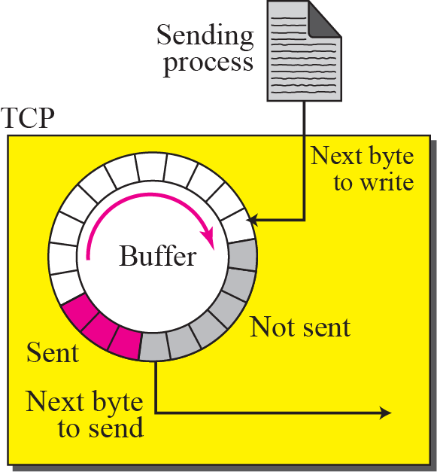
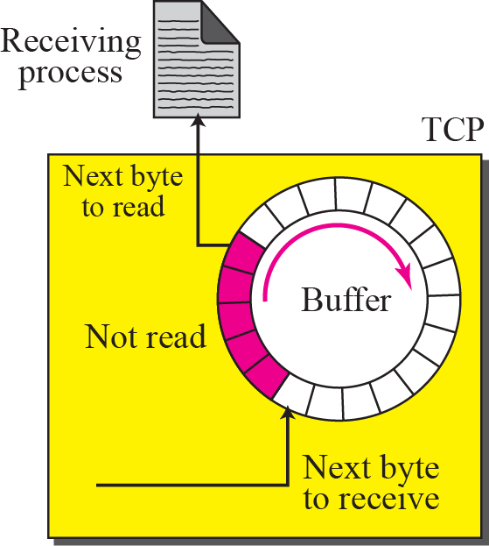
Figure 15.3 Sending and receiving buffers
One way to implement a buffer is to use a circular array of 1-byte locations .
Shows two buffers of 20 bytes each; normally the buffers are hundreds or thousands of bytes.
Also show the buffers as the same size, which is not always the case.

Slide 9
Figure 15.3 Sending and receiving buffers
At the sender, the buffer has three types of chambers.
white section : contains empty chambers that can be filled by the sending process.
colored area : holds bytes that have been sent but not yet acknowledged.
Shaded area : contains bytes to be sent by the sending TCP.
TCP may be able to send only part of this shaded section. This could be due to the slowness of the receiving process, or congestion in the network.
At the receiver buffer is divided into two areas.
white area : contains empty chambers to be filled by bytes received from the network.
colored sections : contain received bytes that can be read by the receiving process.

Slide 10
Figure 15.4 TCP segments
Segments
TCP groups a number of bytes together into a packet called a segment.
Segments are not necessarily all the same size.
Figure shows one segment carrying 3 bytes and the other carrying 5 bytes.
In reality, segments carry hundreds, if not thousands, of bytes.

Slide 11
Full-Duplex Communication
TCP offers full-duplex service, where data can flow in both directions at the same time.
Each TCP endpoint then has its own sending and receiving buffer, and segments move in both directions.

Slide 12
Multiplexing and Demultiplexing
TCP performs multiplexing at the sender and demultiplexing at the receiver.
Since TCP is a connection-oriented protocol, a connection needs to be established for each pair of processes.

Slide 13
Connection-Oriented Service
TCP is a connection-oriented protocol.
When a process at site A wants to send to and receive data from another process at site B, the following three phases occur:
1. The two TCPs establish a virtual connection between them.
2. Data are exchanged in both directions.
3. The connection is terminated.
Note that this is a virtual connection, not a physical connection.
TCP segment is encapsulated in an IP datagram and can be sent out of order, or lost, or corrupted, and then resent.
Each may be routed over a different path to reach the destination.
TCP creates a stream-oriented environment in which it accepts the responsibility of delivering the bytes in order to the other site.

Slide 14
Figure 15.4 TCP segments
Reliable Service
TCP is a reliable transport protocol.
It uses an acknowledgment mechanism to check the safe and sound arrival of data.

Slide 15
15-2 TCP FEATURES

Slide 16
Numbering System
Flow Control
Error Control
Congestion Control

Slide 17
Numbering System
TCP software keeps track of the segments being transmitted or received.
There is no field for a segment number value in the segment header.
Instead, there are 2 fields called sequence number and acknowledgment number.
These two fields refer to a byte number and not a segment number.

Slide 18
Byte Number
TCP numbers all data bytes (octets) that are transmitted in a connection.
Numbering is independent in each direction.
When TCP receives bytes of data from a process, TCP stores them in the sending buffer and numbers them.
TCP chooses an arbitrary number between 0 and 2³²− 1 for the number of the first byte.
If the number happens to be 1,057 and the total data to be sent is 6,000 bytes, the bytes are numbered from 1,057 to 7,056.

Slide 19

Note
The bytes of data being transferred in each connection are numbered by TCP.
The numbering starts with an arbitrarily generated number.

Slide 20
Sequence Number
After the bytes have been numbered, TCP assigns a sequence number to each segment that is being sent.
Sequence number for each segment is the number of the first byte of data carried in that segment.

Slide 21
Note
The value in the sequence number field of a segment defines the number assigned to the first data byte contained in that segment.

Slide 22
Example 15.1
Suppose a TCP connection is transferring a file of 5,000 bytes. The first byte is numbered 10,001. What are the sequence numbers for each segment if data are sent in five segments, each carrying 1,000 bytes?

Slide 23
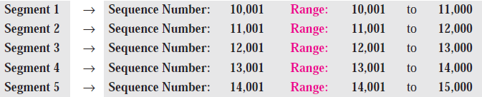
Example 15.1
Suppose a TCP connection is transferring a file of 5,000 bytes. The first byte is numbered 10,001. What are the sequence numbers for each segment if data are sent in five segments, each carrying 1,000 bytes?
Solution
The following shows the sequence number for each segment:

Slide 24
When a segment carries a combination of data and control information (piggybacking), it uses a sequence number.
If a segment does not carry user data, it does not logically define a sequence number. The field is there, but the value is not valid.
However, some segments, when carrying only control information, need a sequence number to allow an acknowledgment from the receiver.
These segments are used for connection establishment, termination, or abortion.
Each of these segments consume one sequence number as though it carries one byte, but there are no actual data.

Slide 25
Acknowledgment Number
When a connection is established, both parties can send and receive data at the same time.
Each party numbers the bytes, usually with a different starting byte number.
Each party also uses an acknowledgment number to confirm the bytes it has received.
The acknowledgment number defines the number of the next byte that the party expects to receive.
In addition, the acknowledgment number is cumulative.
The term cumulative here means if a party uses 5,643 as an acknowledgment number, it has received all bytes from the beginning up to 5,642.

Slide 26
Note
The value of the acknowledgment field in a segment defines the number of the next byte a party expects to receive.
The acknowledgment number is cumulative.

Slide 27
Flow Control
The sending TCP controls how much data can be accepted from the sending process; the receiving TCP controls how much data can to be sent by the sending TCP.
This is done to prevent the receiver from being overwhelmed with data.
Error Control
To provide reliable service, TCP implements an error control mechanism.
Although error control considers a segment as the unit of data for error detection (loss or corrupted segments), error control is byte-oriented
Congestion Control
TCP, takes into account congestion in the network.
The amount of data sent by a sender is not only controlled by the receiver (flow control), but is also determined by the level of congestion, if any, in the network.

Slide 28
15-3 SEGMENT
A packet in TCP is called a segment.
The segment consists of a header of 20 to 60 bytes, followed by data from the application program.
The header is 20 bytes if there are no options and up to 60 bytes if it contains options.

Slide 29
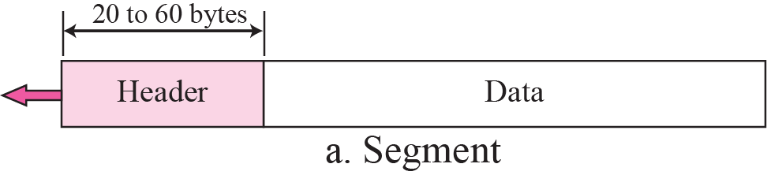
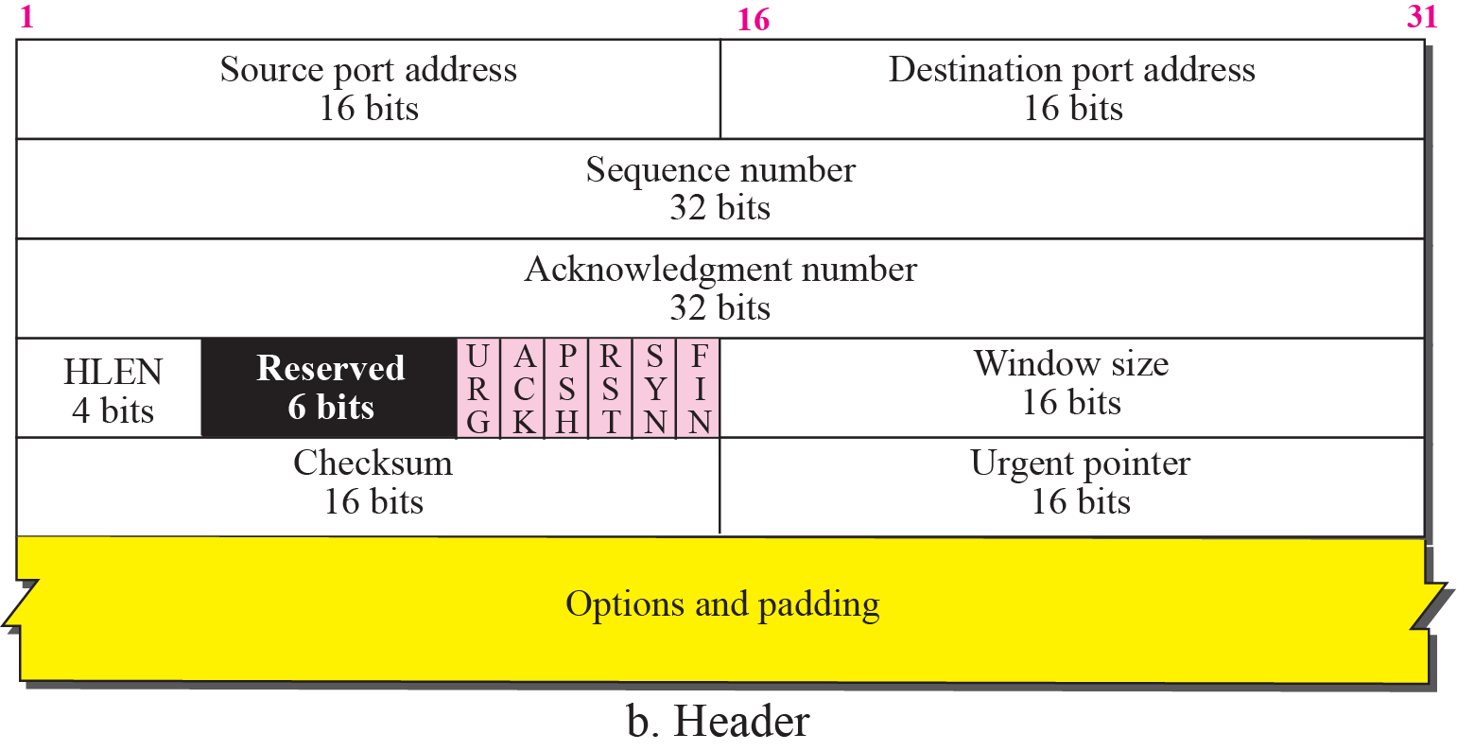
Figure 15.5 TCP segment format
Sequence number.
Defines the number assigned to the first byte of data contained in this segment.
During connection establishment each party uses a random number generator to create an initial sequence number (ISN), which is usually different in each direction.

Slide 30
Figure 15.5 TCP segment format
Acknowledgment number.
This 32-bit field defines the byte number that the receiver of the segment is expecting to receive from the other party.
If the receiver of the segment has successfully received byte number x from the other party, it returns x + 1 as the acknowledgment number.
Acknowledgment and data can be piggybacked together.
Header length. Same as IP header length
Reserved. This is a 6-bit field reserved for future use.

Slide 31
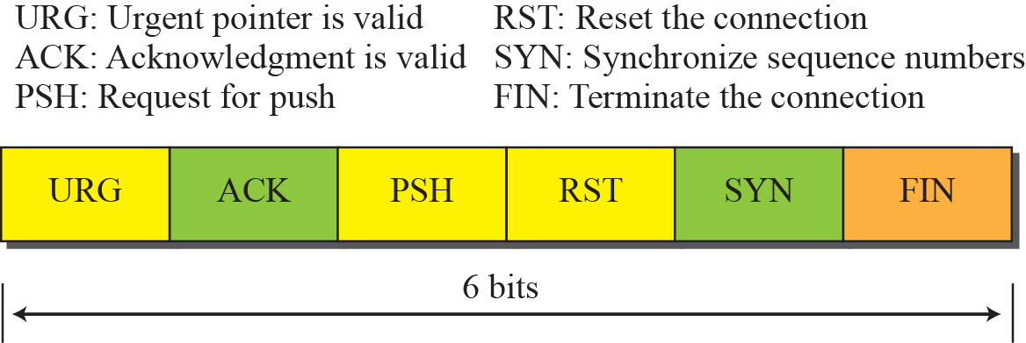
Figure 15.6 Control field
Control.
Defines 6 different control bits or flags.
One or more of these bits can be set at a time. These bits enable flow control, connection establishment and termination, connection abortion, and the mode of data transfer in TCP.

Slide 32
Window size.
Defines the window size of the sending TCP in bytes.
Length of this field is 16 bits, which means that the maximum size of the window is 65,535 bytes. This value is normally referred to as the receiving window (rwnd) and is determined by the receiver.
The sender must obey the dictation of the receiver in this case.
Checksum.
This 16-bit field contains the checksum.
The use of the checksum in the UDP datagram is optional, whereas the use of the checksum for TCP is mandatory.
The same pseudoheader, serving the same purpose, is added to the segment.
For the TCP pseudoheader, the value for the protocol field is 6.

Slide 33
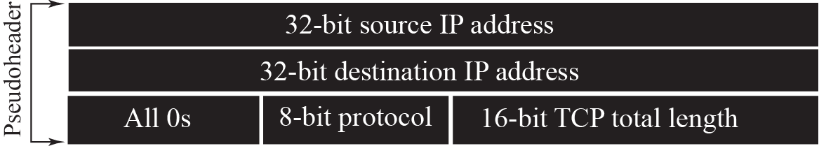
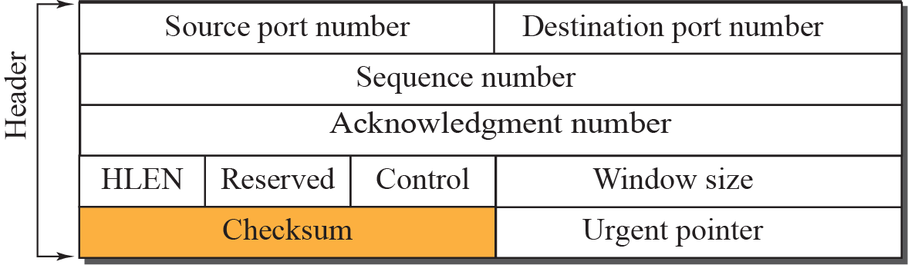

Figure 15.7 Pseudoheader added to the TCP segment

Slide 34
Urgent pointer.
This 16-bit field, which is valid only if the urgent flag is set, is used when the segment contains urgent data.
It defines a value that must be added to the sequence number to obtain the number of the last urgent byte in the data section of the segment.
Options. There can be up to 40 bytes of optional information in the TCP header.

Slide 35
Encapsulation
A TCP segment encapsulates the data received from the application layer.
The TCP segment is encapsulated in an IP datagram, which in turn is encapsulated in a frame at the data-link layer.

Slide 36
Figure 15.8 Encapsulation

Slide 37
15-4 A TCP CONNECTION
TCP is connection-oriented. It establishes a virtual path between the source and destination.
TCP uses the services of IP to deliver individual segments to the receiver, but it controls the connection itself.
If a segment is lost or corrupted, it is retransmitted.
If a segment arrives out of order, TCP holds it until the missing segments arrive; IP is unaware of this reordering.
three phases of TCP connection:
connection establishment,
data transfer, and
connection termination.

Slide 38
Connection Establishment
When two TCPs in two machines are connected, they are able to send segments to each other simultaneously.
Each party must initialize communication and get approval from the other party before any data are transferred.

Slide 39
Three-Way Handshaking
Connection establishment in TCP is called three-way handshaking.
An application program (called client), wants to make a connection with another application program (called server) using TCP .
The process starts with the server.
The server program tells its TCP that it is ready to accept a connection. This request is called a passive open. It cannot make the connection itself.
The client program issues a request for an active open. A client that wishes to connect to an open server tells its TCP to connect to a particular server.
TCP can now start the three-way handshaking process.

Slide 40
Three-Way Handshaking
To show the process we use time lines.
Each segment has values for all its header fields. Here shows only the few fields necessary to understand each phase.
ie : sequence number, acknowledgment number, control flags and window size if relevant.
The three steps in this phase are as follows.

Slide 41
Three-Way Handshaking
1. The client sends the first segment, a SYN segment, in which only the SYN flag is set. This segment is for synchronization of sequence numbers.
Client chooses a random number as the first sequence number and sends this number to the server. This is called the initial sequence number (ISN).
This segment does not contain an acknowledgment number. It does not define the window size either; a window size definition makes sense only when a segment includes an acknowledgment.
SYN segment is a control segment and carries no data. However, it consumes one sequence number. When the data transfer starts, ISN is incremented by 1.

Slide 42
Note
A SYN segment cannot carry data, but it consumes one sequence number.

Slide 43
Three-Way Handshaking
2. The server sends the second segment, a SYN + ACK segment with two flag bits set: SYN and ACK. This segment has a dual purpose.
First, it is a SYN segment for communication in the other direction. The server uses this segment to initialize a sequence number for numbering the bytes sent from the server to the client.
The server also acknowledges the receipt of the SYN segment from the client by setting the ACK flag and displaying the next sequence number it expects to receive from the client.
Because it contains an acknowledgment, it also needs to define the receive window size, rwnd (to be used by the client).

Slide 44
Note
A SYN + ACK segment cannot carry data, but does consume one sequence number.

Slide 45
Three-Way Handshaking
3. The client sends the third segment. This is just an ACK segment. It acknowledges the receipt of the second segment with the ACK flag and acknowledgment number field.
Sequence number in this segment is the same as the one in the SYN segment; the ACK segment does not consume any sequence numbers.
The client must also define the server window size.
Some implementations allow this third segment in the connection phase to carry the first chunk of data from the client. In this case, the third segment must have a new sequence number showing the byte number of the first byte in the data.
The third segment usually does not carry data and consumes no sequence numbers.

Slide 46
Note
An ACK segment, if carrying no data, consumes no sequence number.

Slide 47
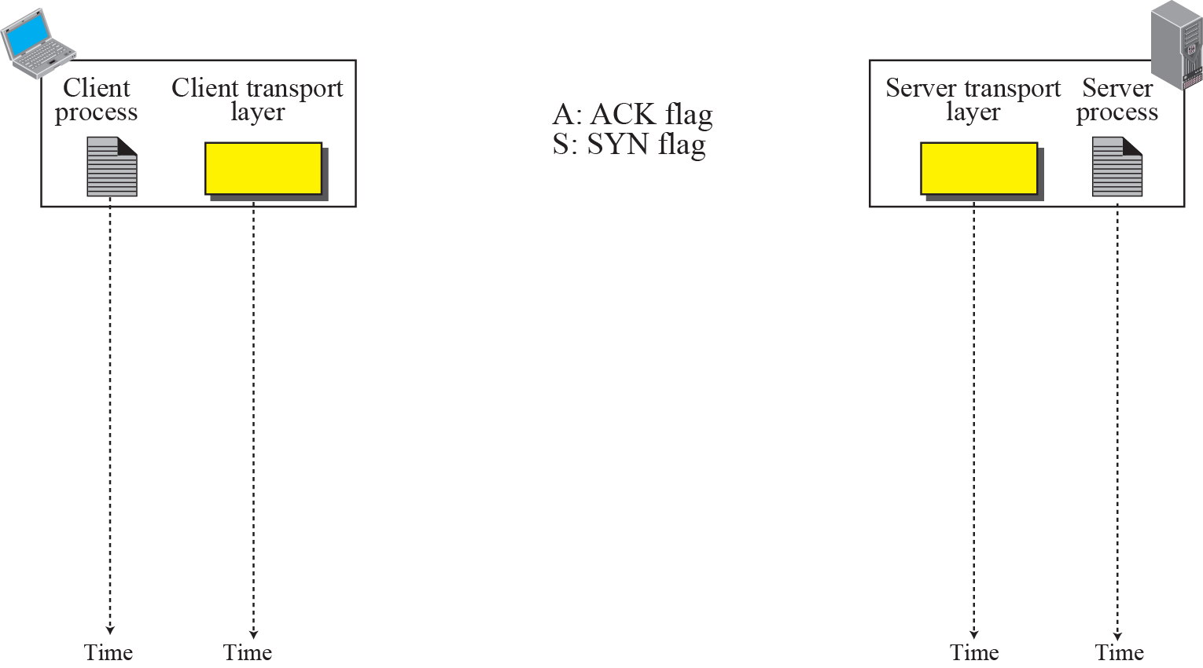

Figure 15.9 Connection establishment using three-way handshake
Means “no data” !
seq: 8001 if piggybacking

Slide 48
SYN Flooding Attack
The connection establishment procedure in TCP is susceptible to a serious security problem called SYN flooding attack.
This happens when one or more malicious attackers send a large number of SYN segments to a server pretending that each of them is coming from a different client by faking the source IP addresses in the datagrams.
The server, assuming that the clients are issuing an active open, allocates the necessary resources. The TCP server then sends the SYN + ACK segments to the fake clients, which are lost.
During this short period of time, the number of SYN segments is large, the server eventually runs out of resources and may be unable to accept connection requests from valid clients.
SYN flooding attack belongs to a group of security attacks known as a denial of service attack.

Slide 49
SYN Flooding Attack
Some implementations of TCP have strategies to alleviate the effect of a SYN attack.
Some have imposed a limit of connection requests during a specified period of time.
Others try to filter out datagrams coming from unwanted source addresses.
One recent strategy is to postpone resource allocation until the server can verify that the connection request is coming from a valid IP address, by using what is called a cookie.

Slide 50
Data Transfer
After connection is established, bidirectional data transfer can take place.
The client and server can send data and acknowledgments in both directions.
The acknowledgment is piggybacked with the data.

Slide 51
Data Transfer
Example : after a connection is established, the client sends 2,000 bytes of data in two segments.
server then sends 2,000 bytes in one segment. The client sends one more segment.
First three segments carry both data and acknowledgment.
Last segment carries only an acknowledgment because there is no more data to be sent.
The data segments sent by the client have the PSH (push) flag set so that the server TCP tries to deliver data to the server process as soon as they are received.
The segment from the server, does not set the push flag.

Slide 52
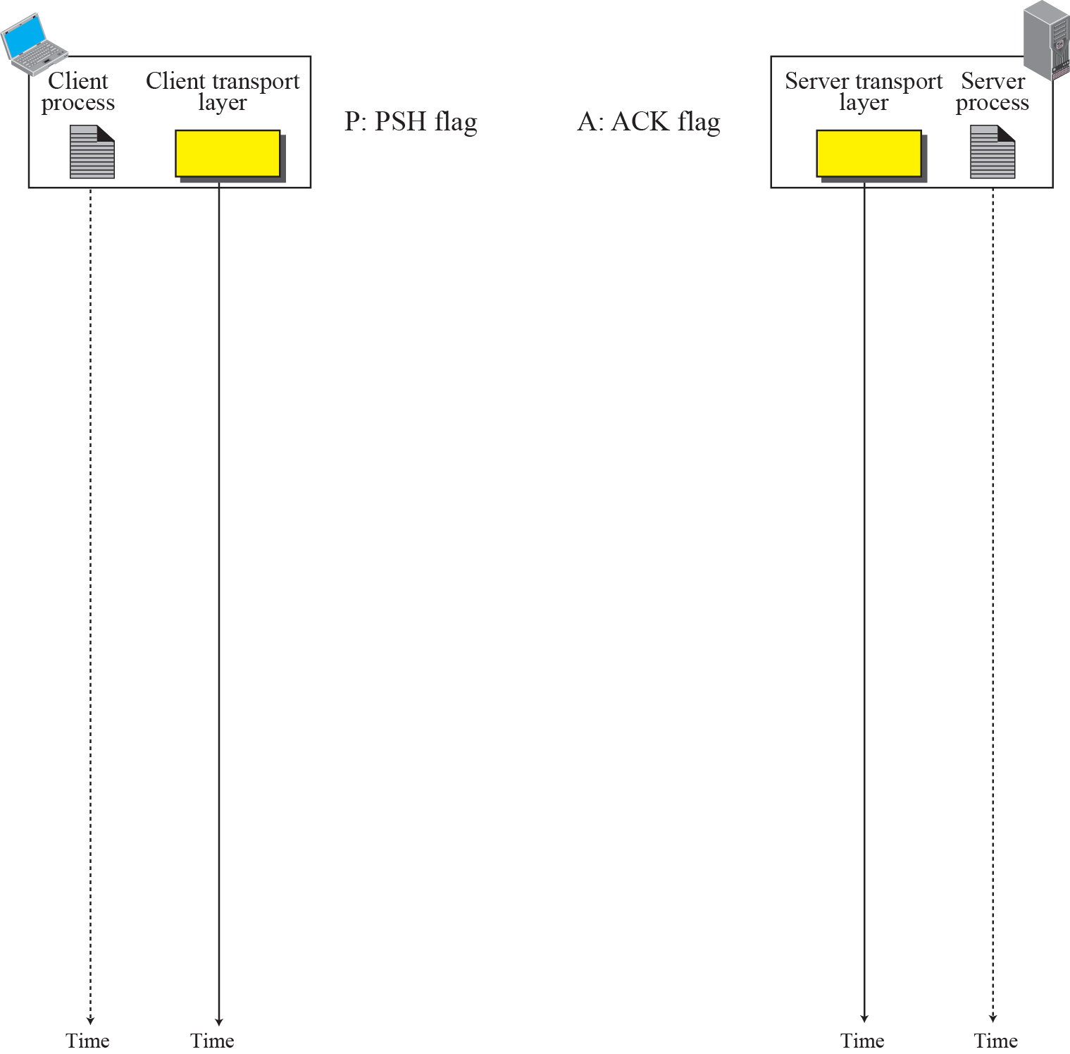
Figure 15.10 Data Transfer
Pushing data
Urgent data

Slide 53
Pushing Data
Sending TCP uses a buffer to store the stream of data coming from the sending process. The sending TCP can select the segment size.
Receiving TCP also buffers the data when they arrive and delivers them to the receiving process when receiving process is ready or when it is convenient for the receiving TCP.
This type of flexibility increases the efficiency of TCP.
There are occasions in which the application program has no need for this flexibility.
Example : consider an application program that communicates interactively with another application program on the other end.
The application program on one site wants to send a keystroke to the application at the other site and receive an immediate response.
Delayed transmission and delayed delivery of data may not be acceptable by the application program.

Slide 54
Pushing Data (cont)
TCP can handle such a situation. The application program at the sender can request a push operation.
This means that the sending TCP must not wait for the window to be filled. It must create a segment and send it immediately.
Sending TCP must also set the push bit (PSH) to let the receiving TCP know that the segment includes data that must be delivered to the receiving application program as soon as possible.
Although the push operation can be requested by the application program, most current TCP implementations ignore such requests.

Slide 55
Urgent Data
There are occasions in which an application program needs to send urgent bytes.
The solution is to send a segment with the URG bit set.
The sending application program tells the sending TCP that the piece of data is urgent. The sending TCP creates a segment and inserts the urgent data at the beginning of the segment. The rest of the segment can contain normal data from the buffer. The urgent pointer field in the header defines the end of the urgent data (the last byte of urgent data).
When the receiving TCP receives a segment with the URG bit set, it informs the
receiving application of the situation.
It is then to the discretion of the receiving program to take an action.

Slide 56
Connection Termination
Any of the two parties involved in exchanging data (client or server) can close the connection, although it is usually initiated by the client.
Most implementations today allow two options for connection termination:
Three-way handshaking and
Four-way handshaking with a half-close option.

Slide 57
Three-Way Handshaking
three-way handshaking for connection termination.
1. In a common situation, the client TCP, after receiving a close command from the client process, sends the first segment, a FIN segment in which the FIN flag is set.
FIN segment can include the last chunk of data sent by the client or it can be just a control segment.

Slide 58
Note
The FIN segment consumes one sequence number if it does not carry data.

Slide 59
Three-Way Handshaking
2. The server TCP, after receiving the FIN segment, informs its process of the situation and sends the second segment, a FIN+ACK segment and at the same time to announce the closing of the connection in the other direction.
This segment can also contain the last chunk of data from the server.

Slide 60
Three-Way Handshaking
3. The client TCP sends the last segment, an ACK segment, to confirm the receipt of the FIN segment from the TCP server.
This segment contains the acknowledgment number, which is one plus the sequence number received in the FIN segment from the server.
This segment cannot carry data and consumes no sequence numbers.

Slide 61
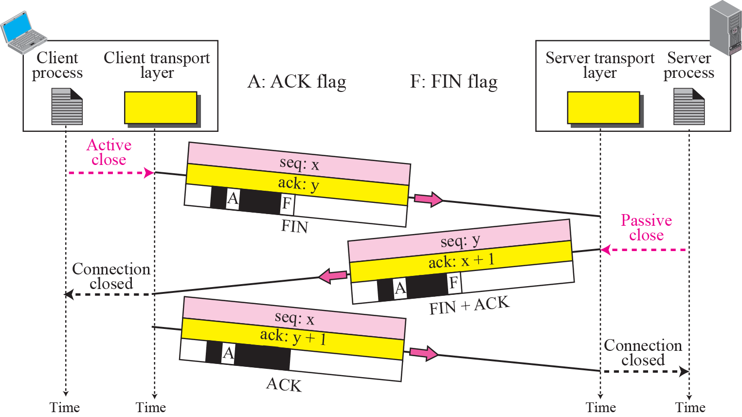
Figure 15.11 Connection termination using three-way handshake

Slide 62
Half-Close
In TCP, one end can stop sending data while still receiving data. This is called a half close.
Either the server or the client can issue a half-close request.
It can occur when the server needs all the data before processing can begin.
A good example is sorting.
When the client sends data to the server to be sorted, the server needs to receive all the data before sorting can start.
This means the client, after sending all data, can close the connection in the client-to-server direction.
However, the server-to-client direction must remain open to return the sorted data.
The server, after receiving the data, still needs time for sorting; its outbound direction must remain open.

Slide 63
Half-Close
Figure shows an example of a half-close. The data transfer from the client to the server stops.
The client half-closes the connection by sending a FIN segment. The server accepts the half-close by sending the ACK segment.
The server, can still send data. When the server has sent all of the processed data, it sends a FIN segment, which is acknowledged by an ACK from the client.
After half closing the connection, data can travel from the server to the client and acknowledgments can travel from the client to the server.
The second segment (ACK) consumes no sequence number. Although the client has received sequence number y − 1 and is expecting y, the server sequence number is still y − 1.
When the connection finally closes, the sequence number of the last ACK segment is still x, because no sequence numbers are consumed during data transfer in that direction.

Slide 64
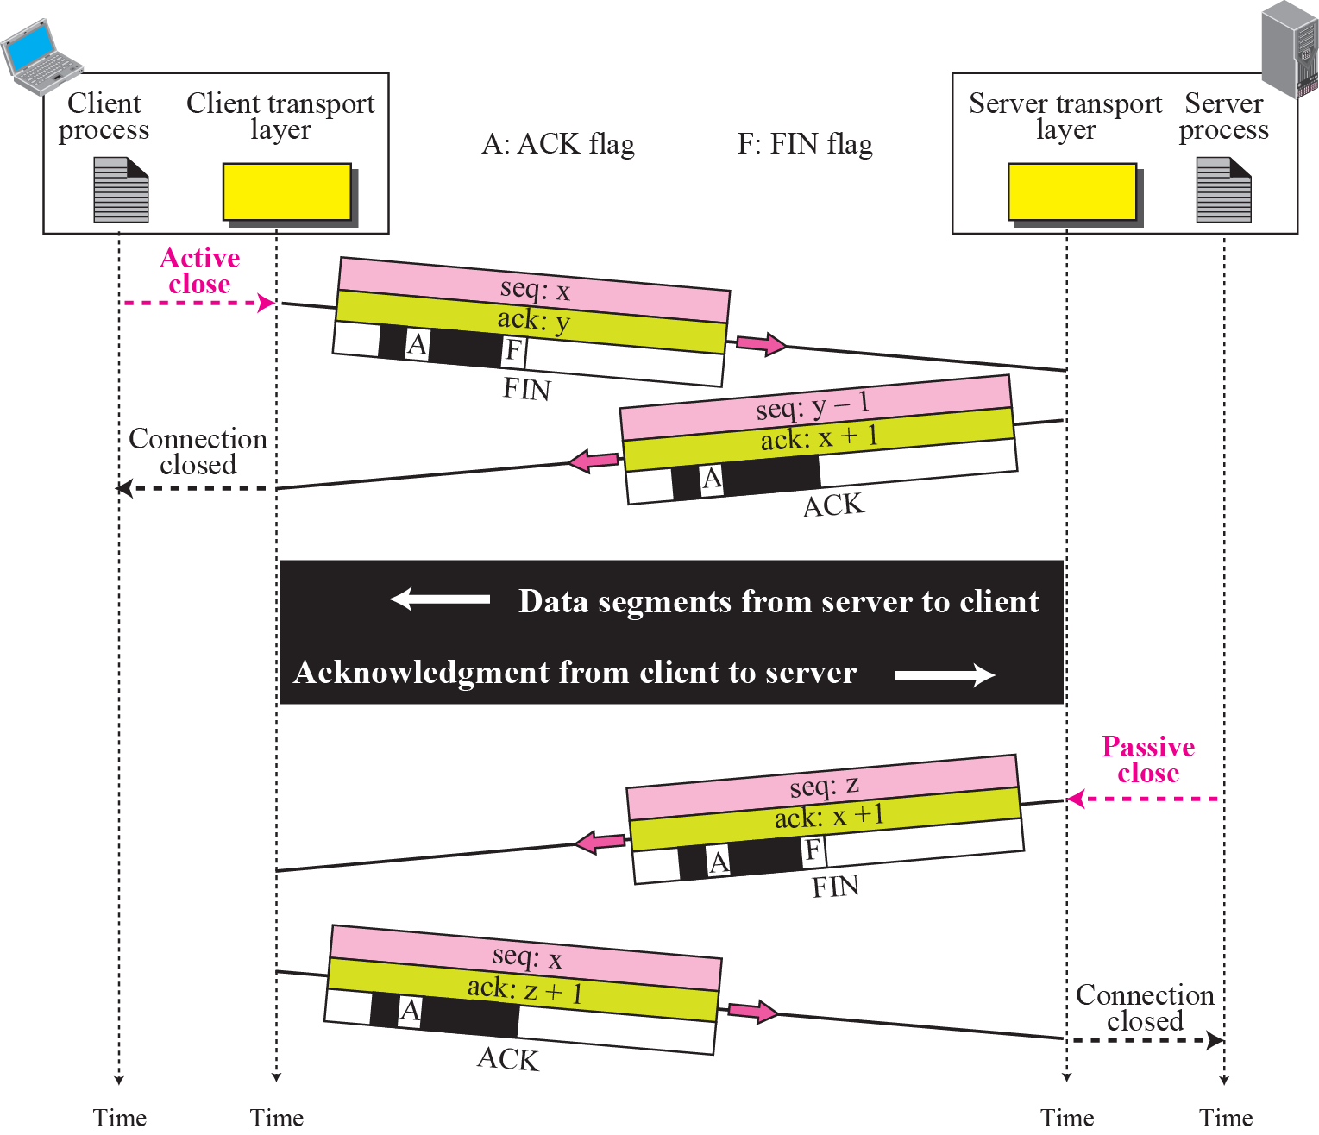
Figure 15.12 Half-Close

Slide 65
Connection Reset
TCP at one end may deny a connection request, may abort an existing connection, or may terminate an idle connection.
All of these are done with the RST (reset) flag.
Denying a Connection
Suppose the TCP on one side has requested a connection to a nonexistent port.
TCP on the other side may send a segment with its RST bit set to deny the request.
Aborting a Connection
One TCP may want to abort an existing connection due to an abnormal situation.
It can send an RST segment to close the connection.

Slide 66
15-5 STATE TRANSITION DIAGRAM
To keep track of all the different events happening during connection establishment, connection termination, and data transfer, TCP is specified as the finite state machine.

Slide 67
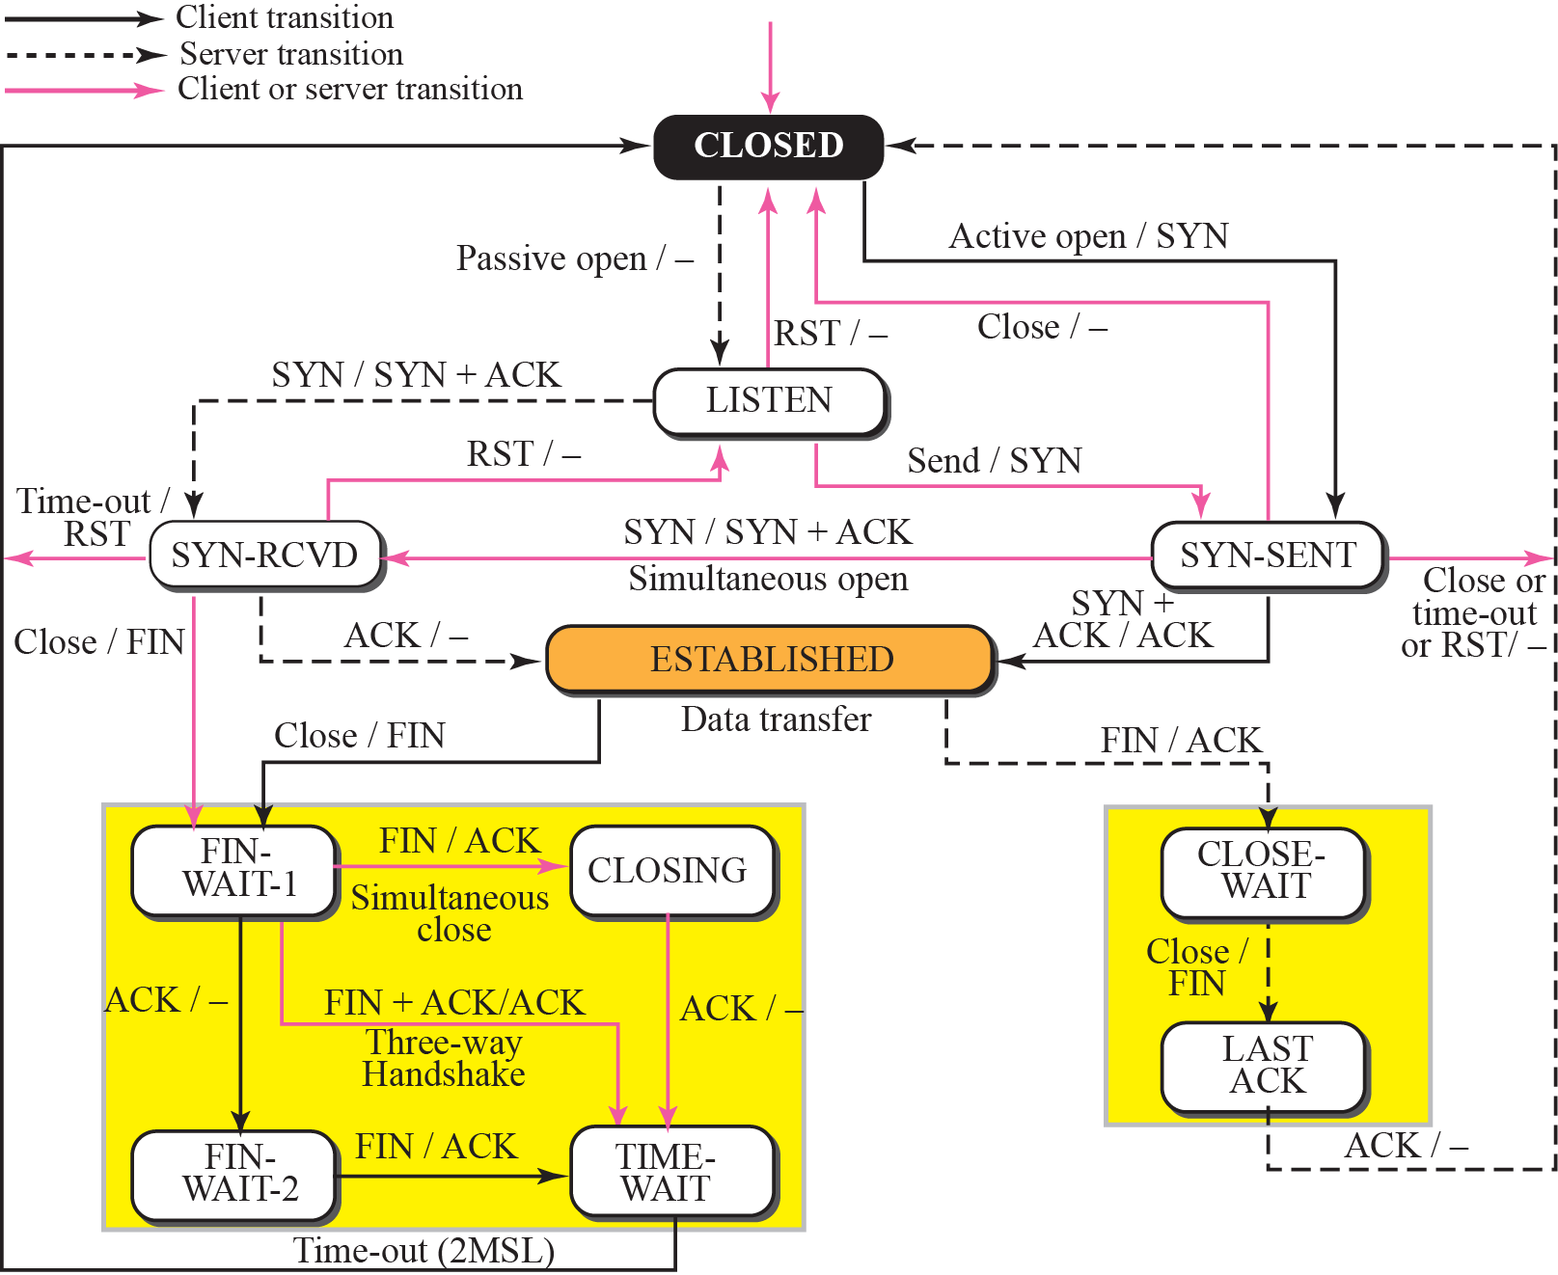
Figure 15.13 State transition diagram
(half-close)

Slide 68
Figure 15.13 State transition diagram
Figure shows 2 FSMs used by the TCP client and server combined in one diagram.
dotted black lines : represent the transition that a server normally goes through;
solid black lines : show the transitions that a client normally goes through.
In some situations, a server transitions through a solid line or a client transitions through a dotted line.
Colored lines show special situations.
Oval marked ESTABLISHED is in fact two sets of states, a set for the client and another for the server.

Slide 69
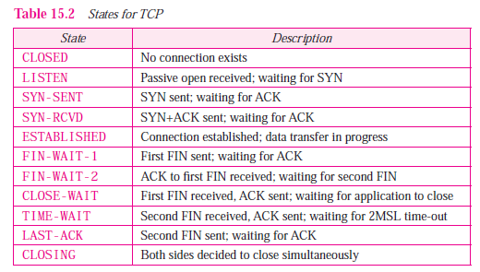

Slide 70
Scenarios

Slide 71
Connection Establishment and Half-Close Termination
Scenario where the server process issues a passive open and passive close, and the client process issues an active open and active close.
The half-close termination allows us to show more states.
Figure 15.14 shows two state transition diagrams for the client and server.
Figure 15.15 shows the same idea using a time-line diagram.

Slide 72
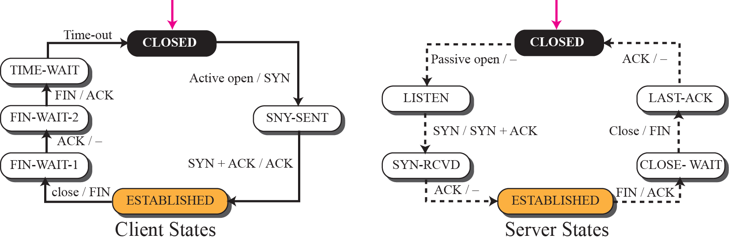
Figure 15.14 Transition diagram for connection and half-close termination

Slide 73
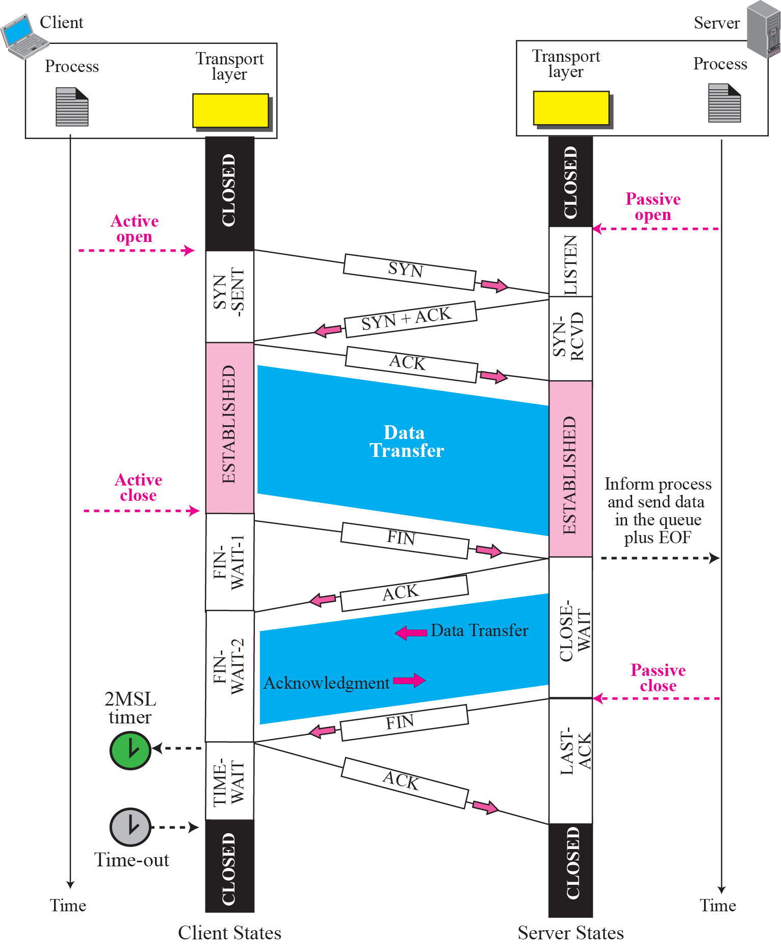
Figure 15.15 Time-line diagram for Figure 15.14
1. Enough time for an ACK to be lost and a new FIN to arrive. If during the TIME-WAIT state, a new FIN arrives, the client sends a new ACK and restarts the 2MSL timer
To prevent a duplicate segment from one connection appearing in the next one, TCP requires that incarnation cannot take place unless 2MSL amount of time has elapsed.
Another solution: the ISN of the incarnation is greater than the last seq. # used in the previous connection.

Slide 74
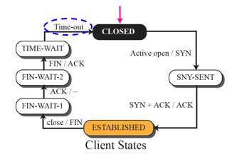
Client States
When the client process has no more data to send, it issues a command called an active close.
Client TCP sends a FIN segment and goes to FIN-WAIT-1 state.
When it receives the ACK for the sent FIN, it goes to FIN-WAIT-2 state and remains there until it receives a FIN segment from the server.
When FIN segment is received, the client sends an ACK segment and goes to the TIME-WAIT state and sets a timer for a time-out value of twice the maximum segment lifetime (MSL).

Slide 75
MSL is the maximum time a segment can exist in the Internet before it is dropped.
The common value for MSL is between 30 seconds and 1 minute.

Slide 76
Two reasons for the existence of the TIME-WAIT state and the 2MSL timer:
If the last ACK segment is lost, the server TCP, which sets a timer for the last FIN, assumes that its FIN is lost and resends it. If the client goes to the CLOSED state and closes the connection before the 2MSL timer expires, it never receives this resent FIN segment, and consequently, the server never receives the final ACK. The server cannot close the connection.

Slide 77
2.
Assume a client and a server have closed a connection. After a short period of time, they open a connection with the same socket addresses. This new connection is called an incarnation of the old one.
A duplicated segment from the previous connection may arrive in this new connection and be interpreted as belonging to the new connection if there is not enough time between the two connections.
To prevent this problem, TCP requires that an incarnation cannot occur unless 2MSL amount of time has elapsed.
Some implementations, ignore this rule if the initial sequence number of the incarnation is greater than the last sequence number used in the previous connection.

Slide 78
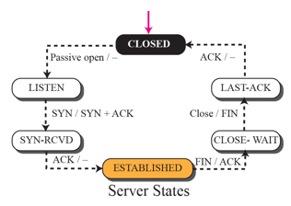
Server States
Either side (client or server) may initiate the close, Here assume that the client initiates the close.
TCP remains in this state until it receives a FIN segment from the client TCP signifying that there are no more data to be sent and that the connection can be closed.
At this moment, the server sends an ACK to the client, delivers outstanding data in its queue to the application, and goes to the CLOSE-WAIT state.

Slide 79
Here, we assume a half-close connection. The server TCP can still send data to the client and receive acknowledgments, but no data can flow in the other direction.
The server TCP remains in this state until the application actually issues a close command.
It then sends a FIN to the client to show that it is closing the connection too, and goes to LAST-ACK state.
It remains in this state until it receives the final ACK, when it then goes to the CLOSED state.

Slide 80
Figure 15.16 Transition diagram for a common scenario
A Common Scenario
Three-way handshake in the connection establishment and connection terminations phases are common.
Figure 15.16 shows the state transition diagram for the client and server in this scenario.

Slide 81
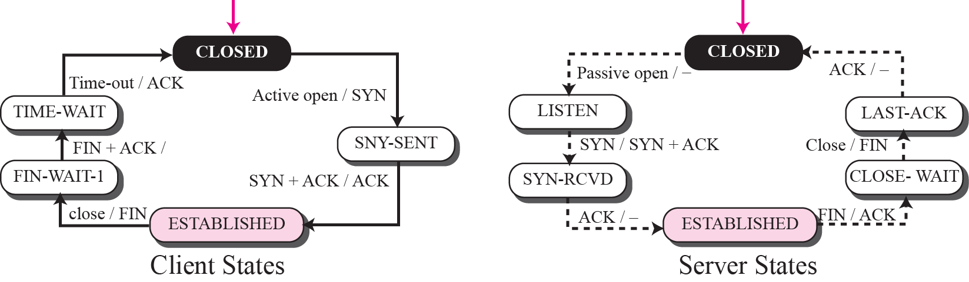
Figure 15.16 Transition diagram for a common scenario
chk

Slide 82
Figure 15.17 shows the same scenario with states over the time line.
Connection establishment phase is the same as the one in the previous scenario;
Here show only the connection termination phase.
The figure shows that the client issues a close after the data transfer phase.
The client TCP sends a FIN segment and goes to FIN-WAIT-1 state. The server TCP, upon receiving the FIN segment, sends all queued data to the server with a virtual EOF marker, which means that the connection must be closed.
It goes to the CLOSE-WAIT state, but postpones acknowledging the FIN segment received from the client until it receives a passive close from its process.
After receiving the passive close command, the server sends a FIN+ACK segment to the client and goes to the LAST-ACK state, waiting for the final ACK.
The client eliminates the FIN-WAIT-2 state and goes directly to the TIME-WAIT state.

Slide 83
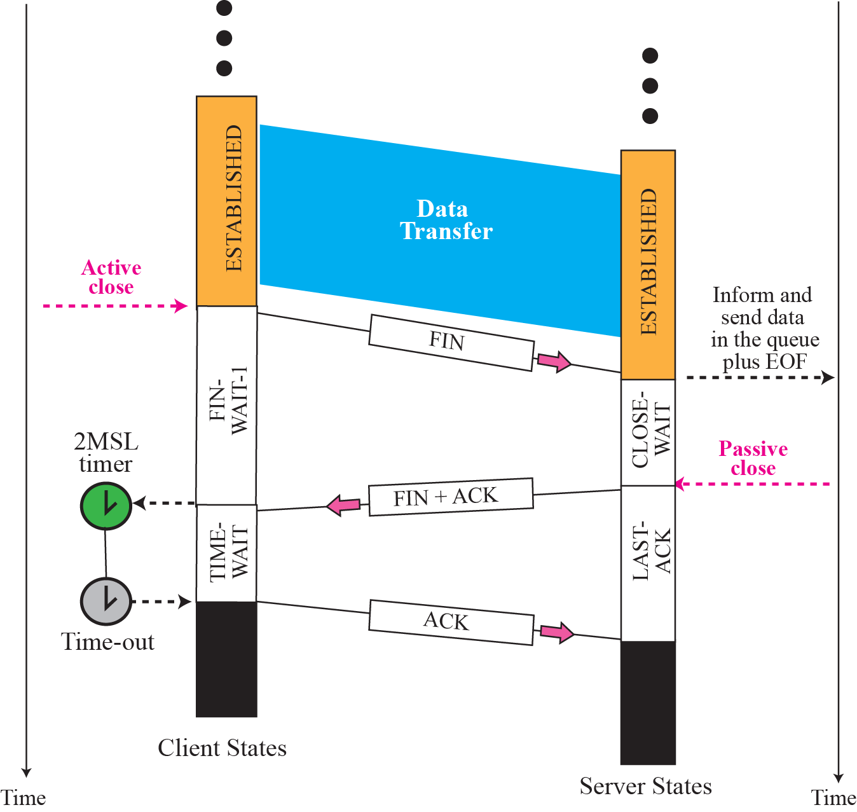
Figure 15.17 Time line for a common scenario

Slide 84
Simultaneous Open
In a simultaneous open, both applications issue active opens.
This is a rare situation in which there is no client or server;
communication is between two peers that know their local port numbers.
The two applications must issue active opens almost at the same time.
Both TCPs go through SYN-SENT and SYN-RCVD states before going to the ESTABLISHED state. A close look shows that both processes act as client and server.
The two SYN+ACK segments acknowledge the SYN segments and open the connection. Note that connection establishment involves a four-way handshake.
The data transfer and the connection termination phases are the same as previous examples.

Slide 85
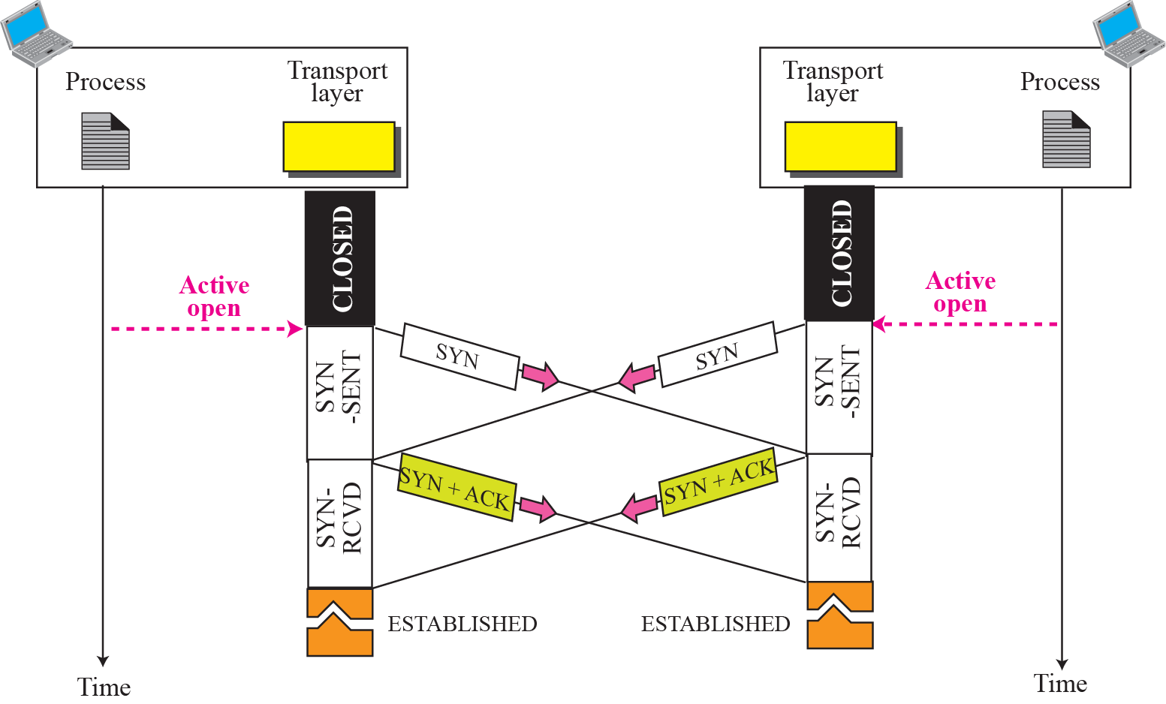
Figure 15.18 Simultaneous open

Slide 86
Figure 15.19 Simultaneous close
Simultaneous Close
Another uncommon, but possible, scenario is the simultaneous close.
In this situation, both ends issue an active close.
Both TCPs go to the FIN-WAIT-1 state and send FIN segments that are in transit simultaneously.
After receiving the FIN segment, each end goes to the CLOSING state and sends an ACK segment.
The CLOSING state takes the place of FIN-WAIT-2 or CLOSE-WAIT in a common scenario.
After receiving the ACK segment, each end moves to the TIME-WAIT state.
Note that this duration is required for both ends because each end has sent an ACK that may get lost.

Slide 87
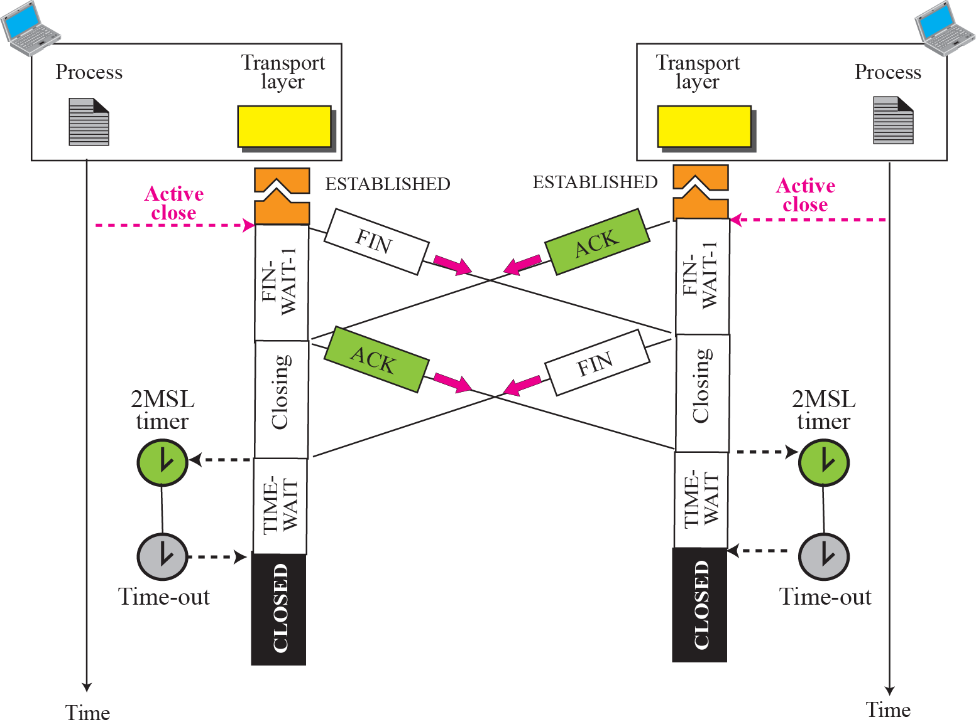
Figure 15.19 Simultaneous close

Slide 88
Denying a Connection
Destination port number in the SYN segment defines a server that is not in the LISTEN state at the moment.
The server TCP, after receiving the SYN segment sends an RST+ACK segment that acknowledges the SYN segment, and, at the same time, resets (denies) the connection.
It goes to the LISTEN state to wait for another connection.
The client, after receiving the RST+ACK, goes to the CLOSED state.

Slide 89
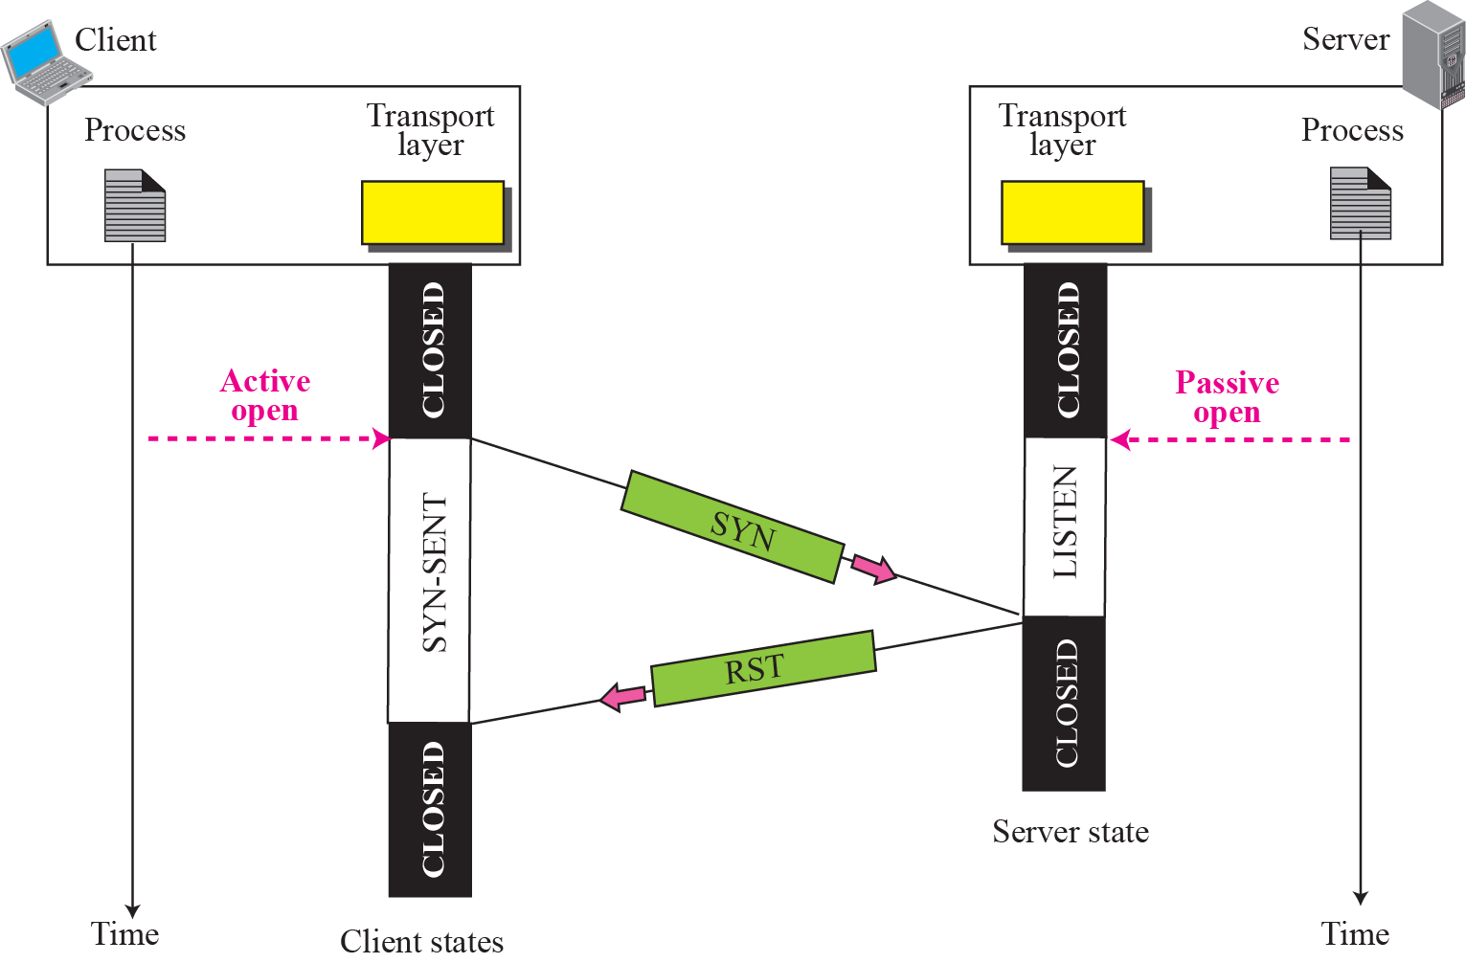
Figure 15.20 Denying a connection

Slide 90
Aborting a Connection
A process can abort a connection instead of closing it.
If the process has failed or does not want the data in the queue to be sent.
TCP may also want to abort the connection. This can happen if it receives a segment belonging to a previous connection (incarnation).
In all of these cases, the TCP can send an RST segment to abort the connection.
Its TCP sends an RST+ACK segment and throws away all data in the queue. The server TCP also throws away all queued data and informs the server process via an error message.
Both TCPs go to the CLOSED state immediately.
no ACK segment is generated in response to the RST segment.

Slide 91
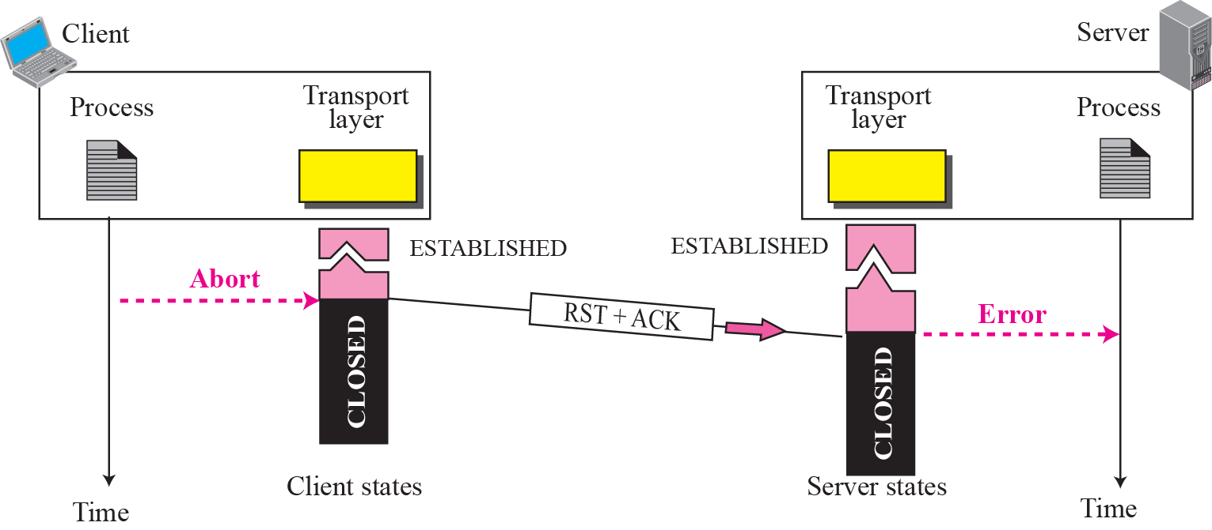
Figure 15.21 Aborting a connection

